Slide 1
Achieving Trusted AI with IBM Watson OpenScale — Manish Bhide, Ph.D. Chief Architect, Trust & Transparency, IBM Watson OpenScale Twitter: @manishbhide1

Slide 3
AI adoption is accelerating… but there is a unique set of challenges
60%
63%
1 in 20
94%
of companies believe AI is key to competitive advantage
see regulatory constraints as a barrier to implementing AI.
cite availability of technical skills as a challenge to implementation.
companies has extensively incorporated AI in offerings or processes.
- IDC
- IBM IBV AI 2018
- IBM IBV AI 2018
- MIT Sloan Management Review
Notes:
Data, Skills, Trust
IBM’s institute for Business value just released a survey of 5,000 C-level executives and found that clients are ready, in fact, 82% of enterprises are now considering AI adoption.
However, the MIT Sloan Management Review is showing us that only 1 in 20 companies have extensively incorporated AI.
In our work with our own clients we see the struggles they face in adopting AI. 60% of companies see compliance as barriers to achieving success in applying AI, because they cannot trust the decisions
One of the major barriers for adopting AI is lack of trust. Businesses need to be able to explain how the AI systems came to a certain decision: whether there was bias in data, where was the model built, how did it make certain decisions, etc.
At IBM, we’ve been working diligently to address these issues.
We have been working on trying to solve AI’s “black box” issue.
What does this mean?
Well, we need to demystify AI for businesses. They have heard of the results that they can achieve, but they’re still struggling to be figure out how it works. How do they trust the results?
We’re taking two important steps towards addressing these issues.
The first step is we are introducing a comprehensive new set of trust and transparency capabilities for AI on the IBM Cloud.
What we’ve launched is a software service that explains how AI decisions are reached and flags and helps mitigate bias.
It provides explainability and bias detection on AI models – at runtime – detecting potentially unfair outcomes as they occur.
Importantly, it also automatically recommends data to add to the model to help mitigate any bias it has detected in the AI.
While other open-source resources have focused solely on checking for bias in training data, IBM Research has created the “IBM AI Fairness 360 toolkit” which is the second step.
This toolkit will help developers and data scientists check for and mitigate bias in AI models and we are also making it available to the open source community.
The AI Fairness 360 toolkit is a mix of novel algorithms, code, algorithms, libraries and tutorials that will incorporate known bias-handling capabilities.
This toolkit aligns to IBM’s longstanding commitment to advancing open systems in all technology, including AI.
This is important for our clients because it’s all about visibility into AI decisions.
As I discussed earlier, clients need a way to address the “black box” – they need to trust in AI in order to take advantage of the benefits it can have for their business.
You don’t need to be a data scientist or developer to use this service.
It provides easy to understand terms – why AI made a recommendation – showing which factors weighted the decision in one direction vs. another.
To help prevent bias that may lead to unfair outcomes, the software service can also be programmed to monitor the unique decision factors of any business workflow.

Slide 4


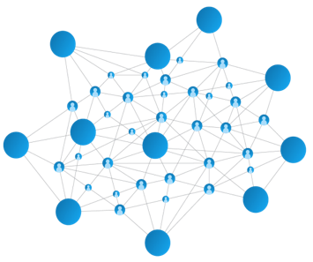
The AI Ladder
A Prescriptive Approach to Accelerating the Journey to AI
INFUSE – Deploy trusted AI-driven business processes
ANALYZE – Scale insights with ML everywhere
ORGANIZE – Create a trusted analytics foundation
COLLECT – Make data simple and accessible
MODERNIZE your data estate for an AI and multi-cloud world
Data of every type, regardless of where it lives
4
4

Slide 5

Watson OpenScale
The open platform to accelerate adoption of AI into workflows with confidence
Designed to allow anyone in the organization to understand the decisions that AI is making:
Detect fairness issues at runtime
Automatic bias mitigation without model retraining
Provides traceability and auditability of AI predictions
Gain insight into model inference
Model Ops and explainability
→ All offered in state-of the art UI ←
AI for AI: Neural Network Synthesis – NeuNetS Exposed through Watson OpenScale, NeuNets is a fundamentally new AI system technique for Neural Network design that automatically designs a new neural network or evolves a neural network from existing ones.
Available on Public and Private Cloud

Slide 6


Infuse AI Everywhere, with confidence
Deploy Trusted AI-Driven Business Processes
Watson OpenScale
Operational Fabric for AI
Watson Applications & Industry Solutions
Watson
Studio
Development
Environment
Watson
Machine Learning
Runtime
Environment
Watson
Services APIs
Language, Tone, Speech, etc.
Open Source Technologies
Cloud Private for Data
Multicloud Data Fabric for AI

Slide 7
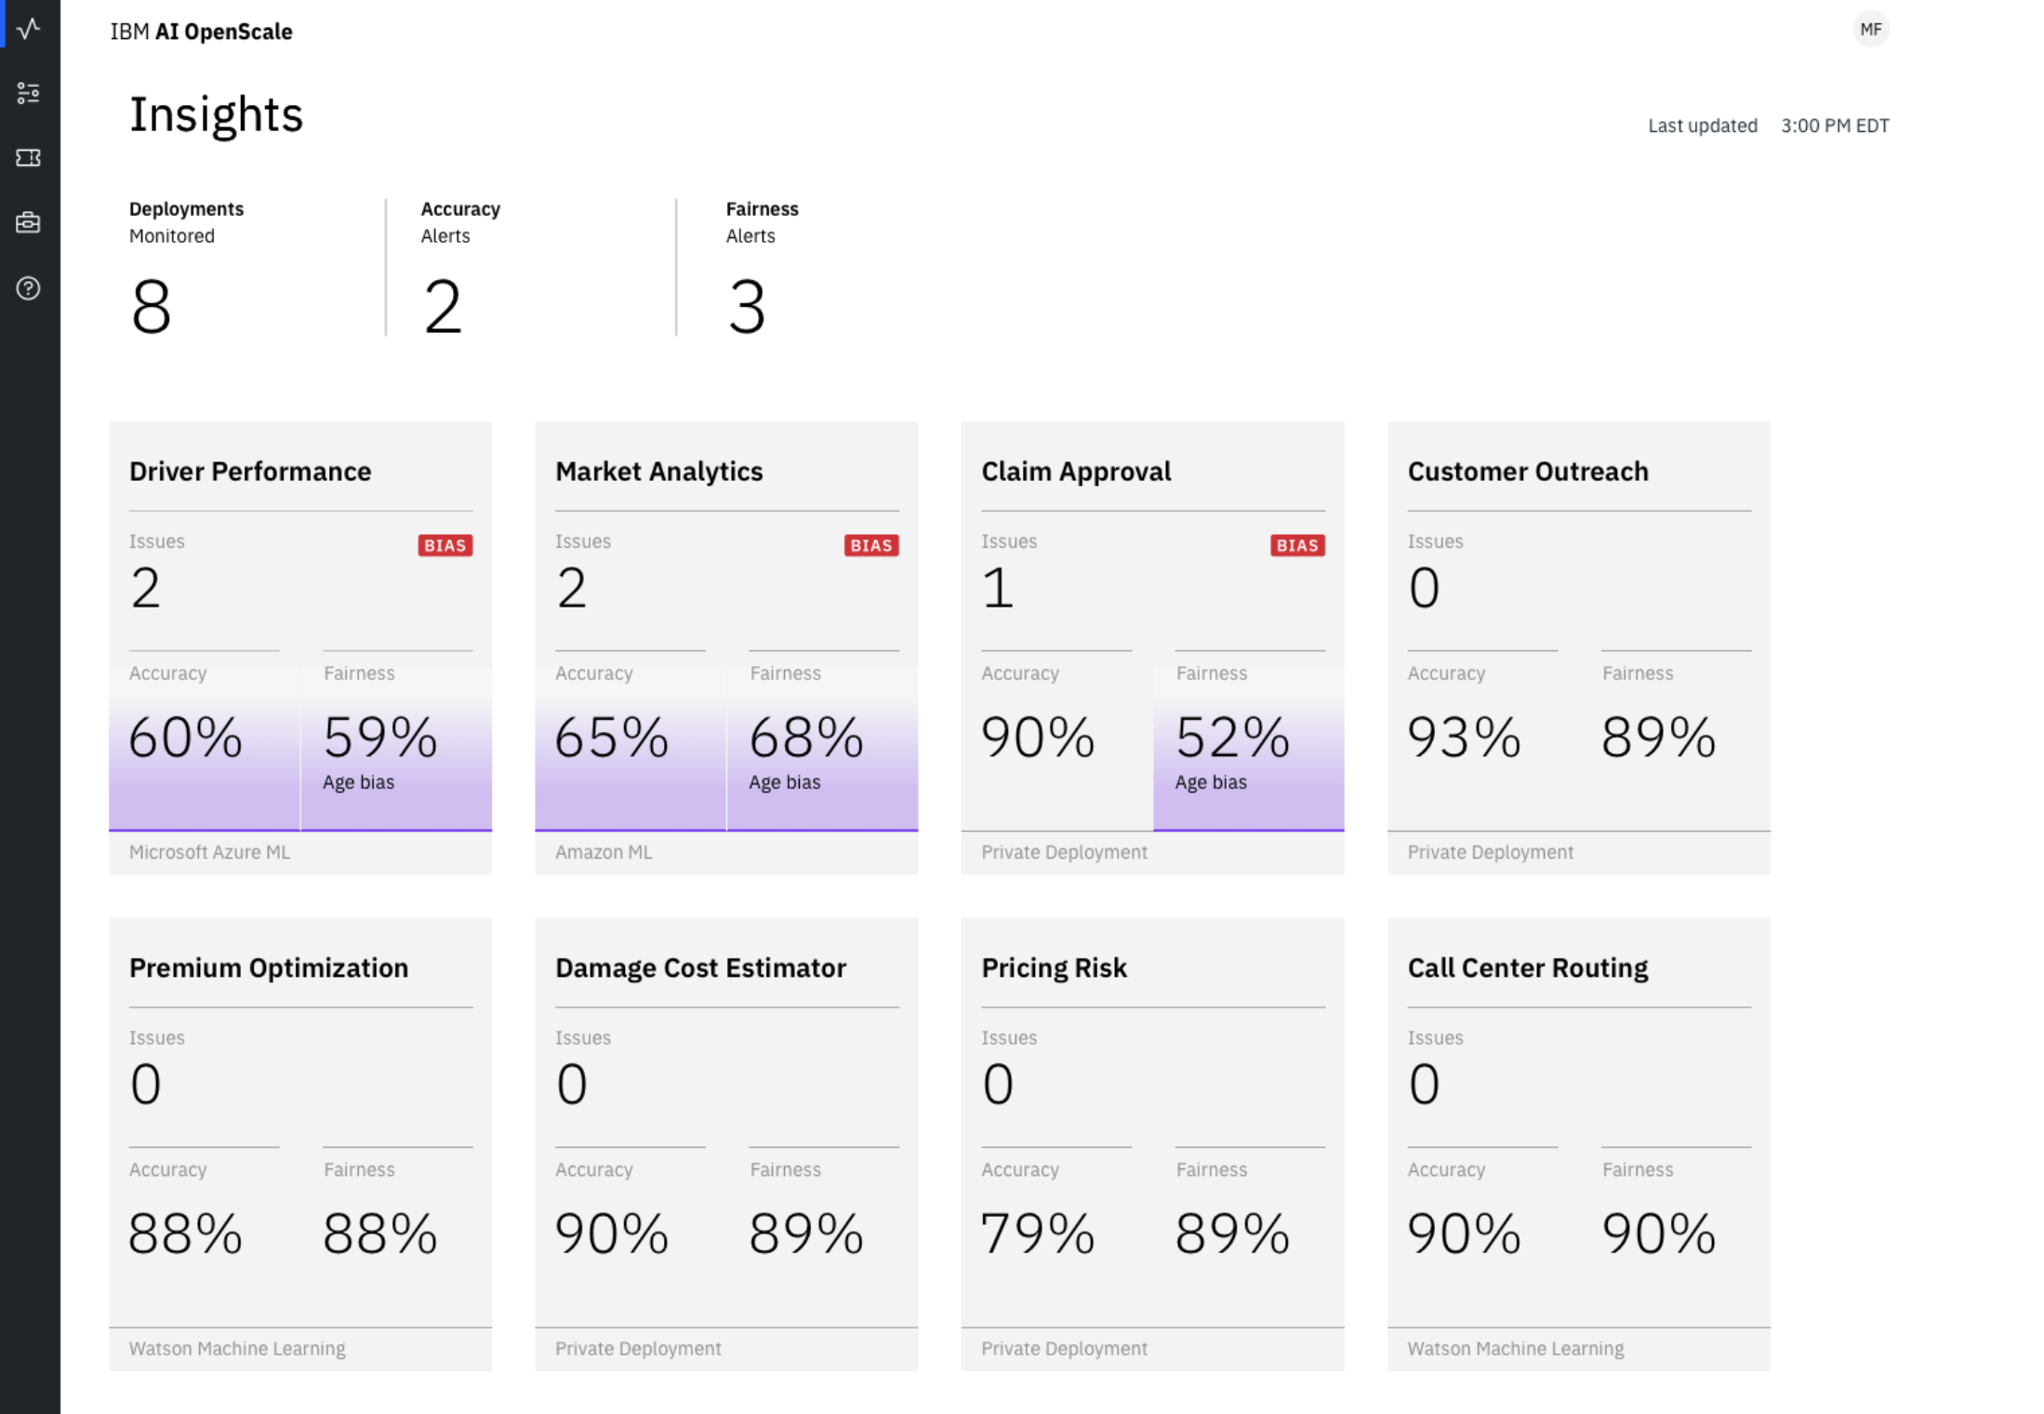
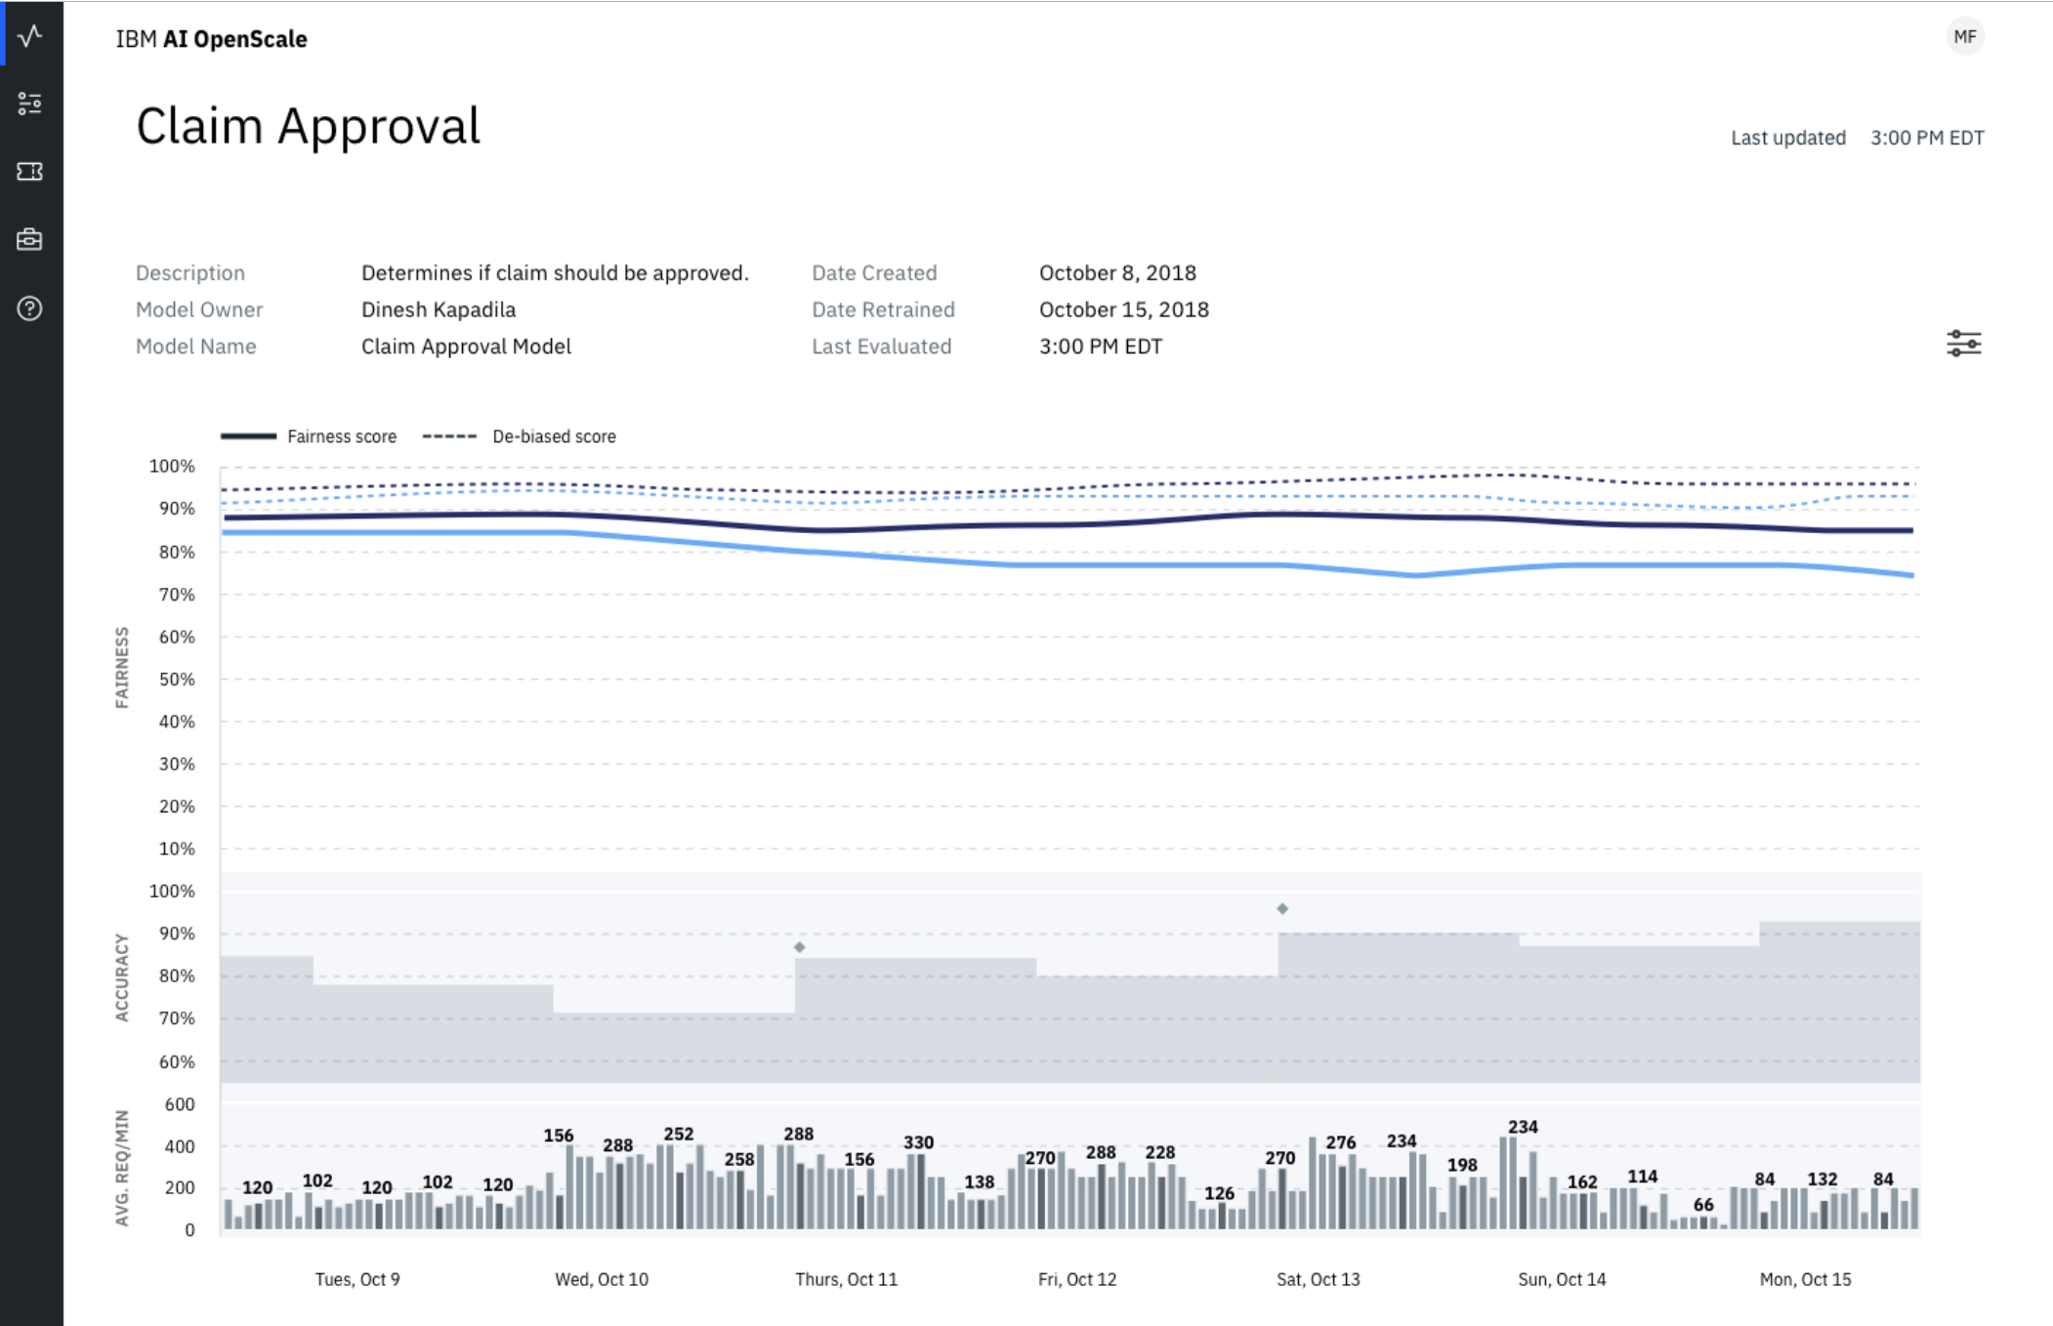
IBM Watson OpenScale Automate and Operate AI at Scale
Trust and Transparency
Intelligently delivers bias mitigation help
Provides traceability & auditability of AI predictions made in production applications
Tracks AI accuracy in applications
Explains an outcome in business terms
Automation
Automatically detects and mitigates bias in model output, without affecting currently deployed model or outcomes
NeuNetS (beta) – automatically generates Neural Networks
Open by Design
Monitor and optimize models deployed on third party model serve engines.
Deploy behind enterprise firewall or on IaaS provider

Slide 8
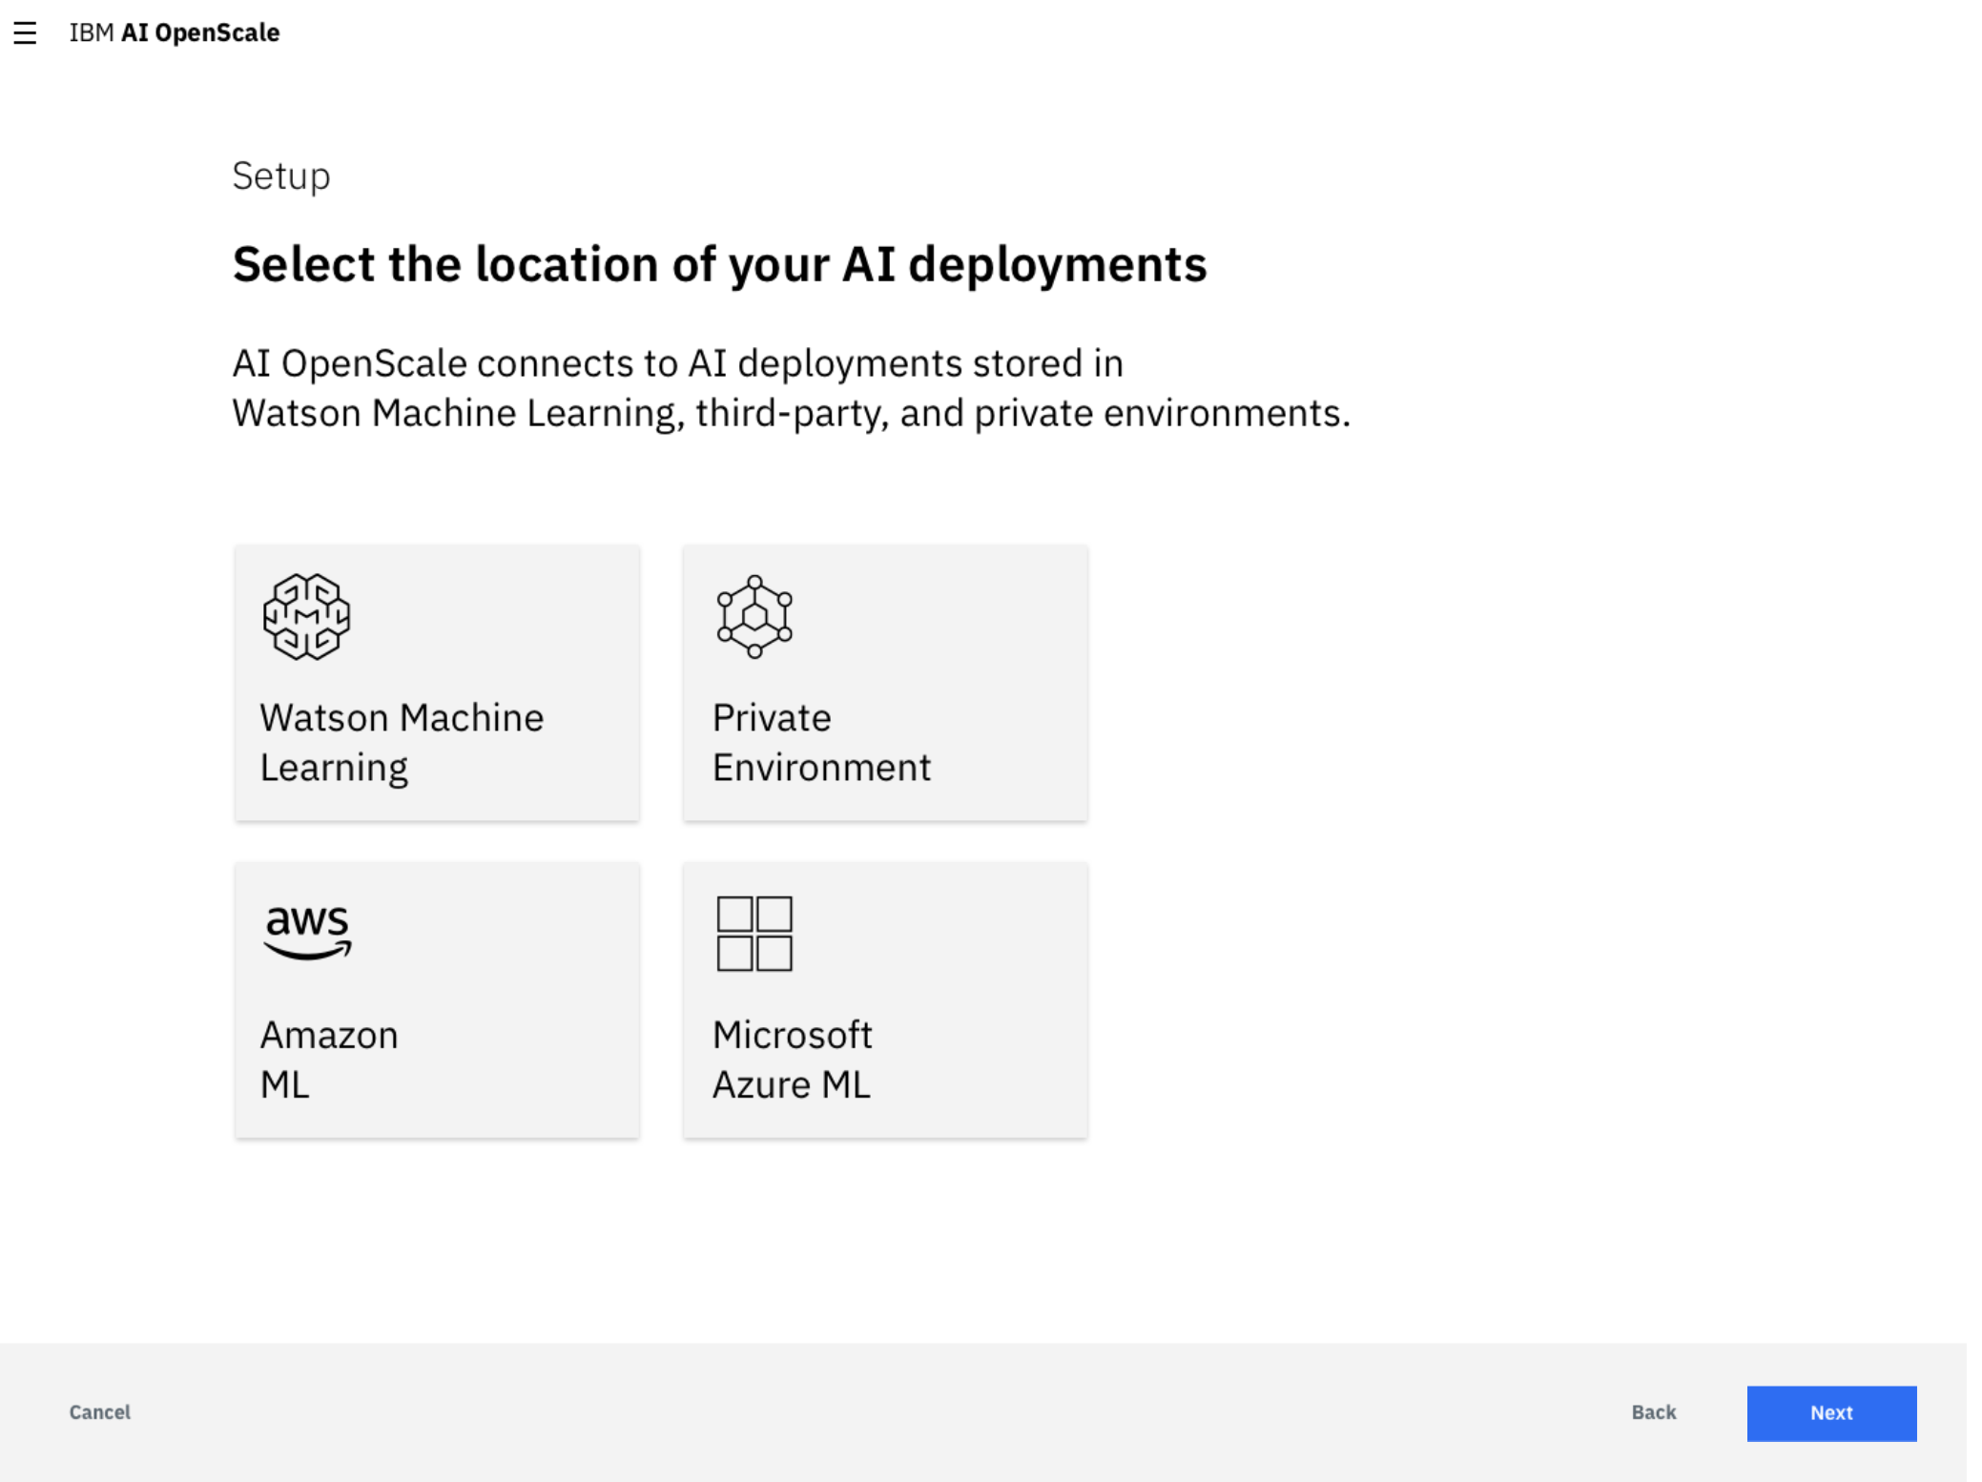
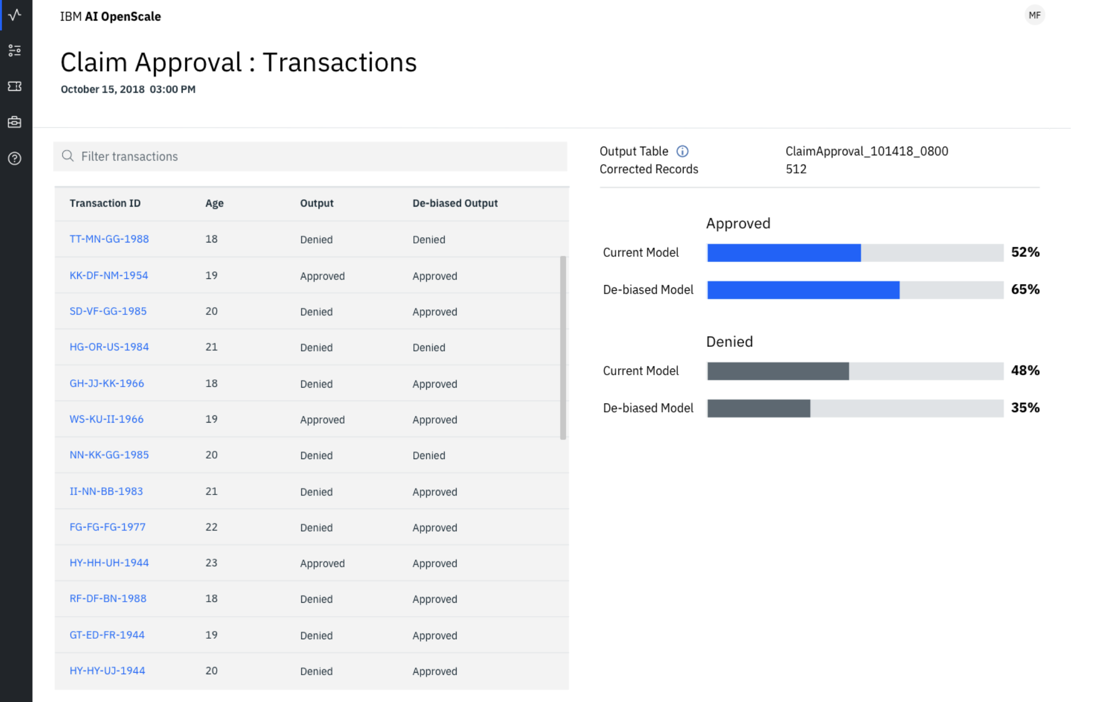
IBM Watson OpenScale Update: What’s New! Functionality available 2018.12.14
IBM Cloud Private and Public Standard Plan
Automatically detect and mitigates bias issues at runtime
Enhanced explain-ability with contrastive explanations providing visibility into why an AI outcome was delivered and why alternate outcomes were not recommended
Monitor and optimize models deployed on any model serve engine including custom model serve engines
Deploy behind your firewall or IaaS provider of choice
NeuNetS – automatically generate Neural Networks delivering models uniquely tailored to your data (beta)

Slide 9
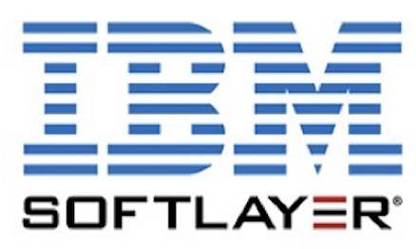



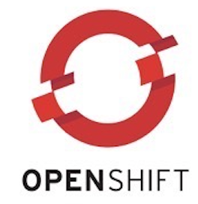
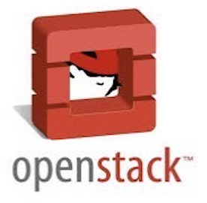
Multi-Cloud Deployment Through IBM Cloud Private
PUBLIC
PRIVATE
Watson OpenScale can be deployed wherever organizations need it
IBM Public Cloud
IBM Cloud Private
Third party cloud providers
Deployment through IBM Cloud Private provides a common installation and management experience wherever the offering is located
Maximize on cloud agility and economics
Cloud native, behind the firewall, client managed
Cloud Native Experience
Regardless of which cloud you choose, you get market leading Watson capabilities.

Slide 10
Demonstration

Slide 11
Thank you.
Manish Bhide
Chief Architect, Trust & Transparency,
IBM Watson OpenScale
—
abmanish@in.ibm.com
+91-800 80 32 000
ibm.com

